Slide 1
Getting Data from the Internet with Python
APIs, Requests, and HTML Parsing
Joseph Kuchar (Statistics Canada)
Data Exploration and Integration Lab (DEIL)
Centre for Special Business Projects (CSBP)

Slide 2
Motivation
There’s a decent chance at some point you may need to acquire structured or unstructured data from the internet, and maybe even automate the process
We can help you hit the ground running with a few working examples
Topics covered:
Requesting data from APIs (Application Program Interface)
Automating downloading data from links
Simple webscraping
The codes and presentation are available at the CANDEV github:
https://github.com/CANDEV-OTTAWA-2020-WORKSHOPS-ORG/
We’ll be using Python 3, and the Requests and BeautifulSoup packages.

Slide 3
Querying APIs with Python
Most web-based APIs are essentially http links with parameters that can be varied based on the request.
The most common way to interact with them in Python is with the requests library.
An API will generally require certain parameters as inputs, and will output information in a formatted xml or json file.
We will look at a few examples using OpenRouteService:
OpenRouteSevice is a geocoding and trip planning service
https://openrouteservice.org/

Slide 4
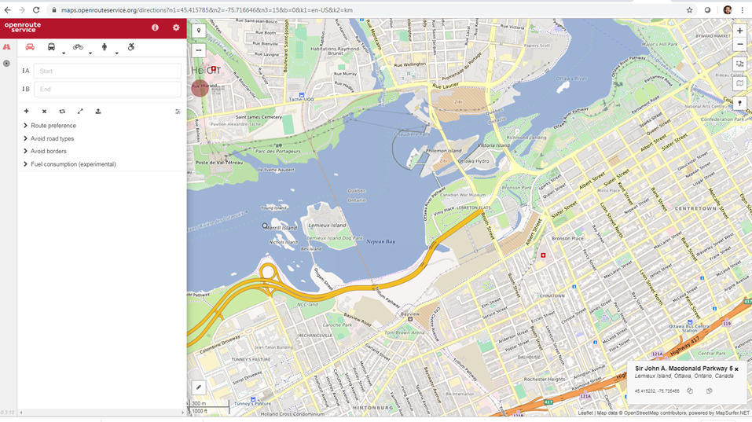
OpenRouteService
https://maps.openrouteservice.org/directions?n1=45.415785&n2=-75.716646&n3=15&b=0&k1=en-US&k2=km
ORS has trip planning capability
Generally accessed through an API
Need to sign up for a free API key
Limits to numbers of requests that can be sent

Slide 5
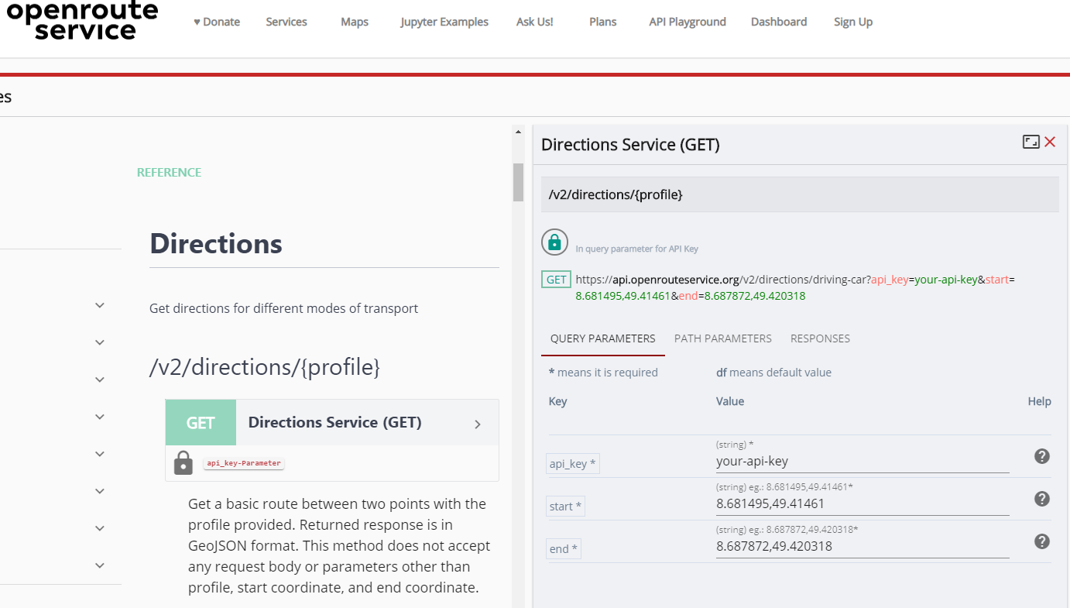
OpenRouteService
https://openrouteservice.org/dev/#/api-docs/v2/directions/{profile}/get
Very good documentation for the API!
To request directions, there are three required parameters passed into the url:
Your API key
Start coordinates (longitude, latitude)
End coordinates

Slide 6
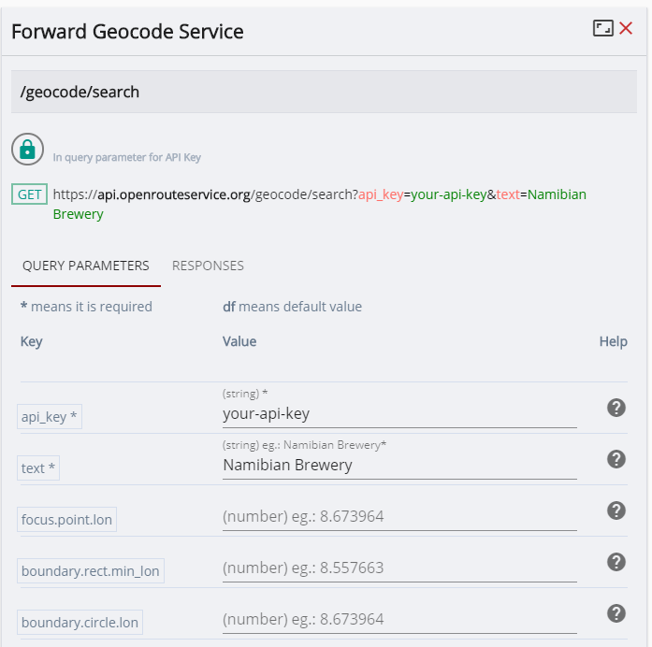
OpenRouteService
https://openrouteservice.org/dev/#/api-docs/v2/directions/{profile}/get
There is also a geocoding service
Geocoding is the process of converting a street address to a geographic coordinate
As an example, we can convert addresses to coordinates, and then find the road network distance between them

Slide 7
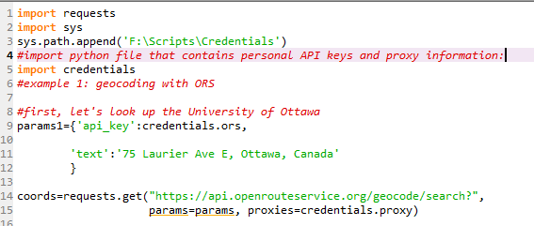
ORS Example
If you’d like to run this yourself, you will need to sign up for an API key and replace credentials.ors with your key, and remove proxies=credentials.proxy

Slide 8
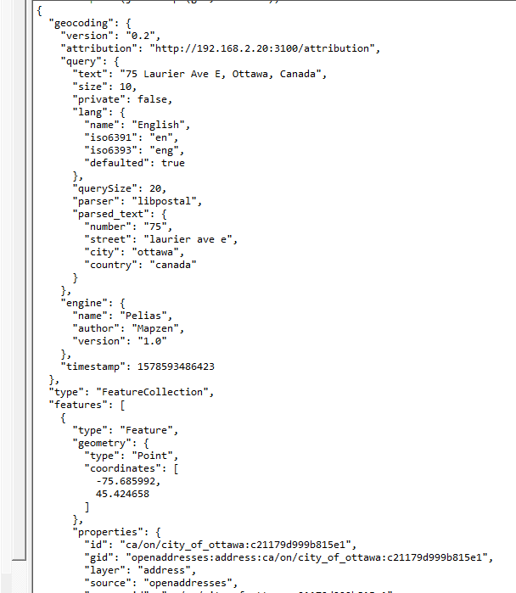
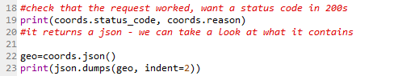
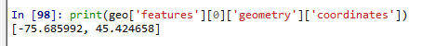
ORS Example
When you print the status code, should get 200
This means it worked properly
400s means a failure
The json is shown at the right – we can see the coordinates are under the “features” key of the json

Slide 9
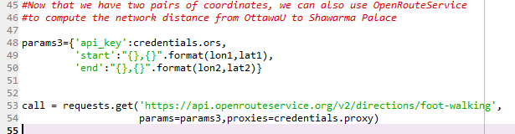
ORS Example
As a second example of geocoding in the script we also get the coordinates for Shawarma Palace (464 Rideau St, Ottawa, Canada). Given both sets of coordinates, we can make a request to determine a route from one to the other:
We’ve selected ‘foot-walking’ as the travel type (could chose something else, e.g., driving)
The API requires three parameters:
Your API key
Start position (‘lon,lat’)
End position (‘lon,lat’)

Slide 10
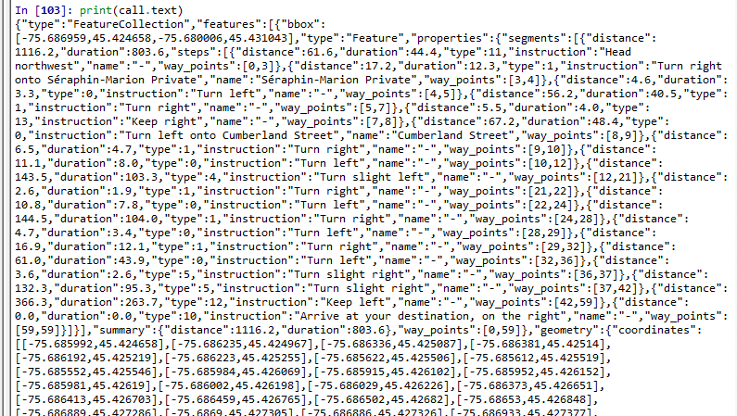
ORS Example
The response is another JSON file with both directions and a summary of distance and time:

Slide 11
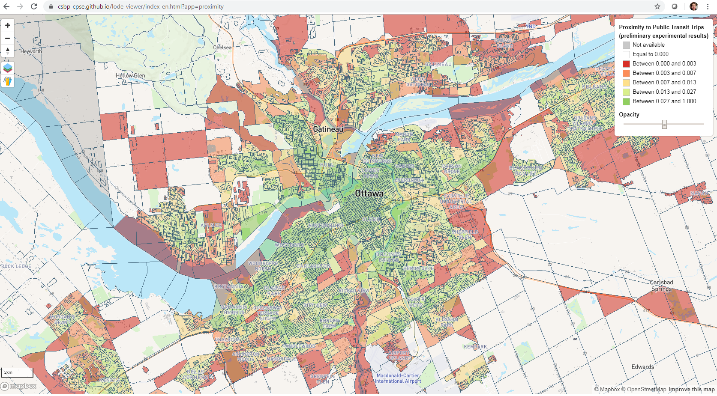
ORS Example – Fun Fact
My team uses a local copy of OpenRouteService to compute network distances to calculate measures of access to services across Canada: https://csbp-cpse.github.io/lode-viewer/index-en.html?app=proximity

Slide 12
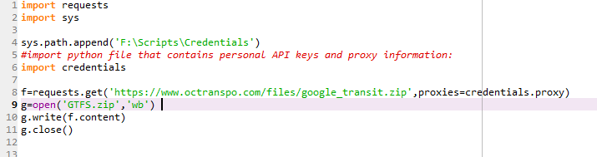
Downloading Data from Links
In addition to accessing APIs, you can use the requests library to download files from the internet.
Example: Downloading transit data from OC Transpo: https://www.octranspo.com/en/plan-your-trip/travel-tools/developers/
The GTFS (General Transit Feed Specification) file is a zipped folder containing text files in a relational database
https://www.octranspo.com/files/google_transit.zip

Slide 13
Downloading Data from Links
I work on the Linkable Open Data Environment at Statistics Canada (https://www.statcan.gc.ca/eng/lode)
We standardise and re-release open data, so far have released databases of building polygons and educational facilities.
Work in development is on our Github: https://github.com/CSBP-CPSE/LODE-ECDO
If you’re interested in transit data, we’ve compiled nearly 100 sources, most of which can be downloaded with an Open License.
https://github.com/CSBP-CPSE/LODE-ECDO/tree/master/sources/Transit/GTFS/Collection
This link also contains a Python code that downloads the GTFS files into Prov/City directories and produces READMEs with attribution*
Note that, in your projects, you should source and provide attribution for any data you use!

Slide 14
Basic Web Scraping
By web scraping, I mean parsing data from a web page from the underlying html.
When web scraping, be respectful:
Websites aren’t typically designed to handle requests with the speed that machines can send them, so if you need to extract information from the same site repeatedly, make sure to build delays in to your code.
Scrape during off-peak hours if possible
Be transparent – do not make attempts to disguise who you are
Similarly, many webpages have a robots.txt file, or terms and conditions, that indicate whether they accept web scrapers. You should abide by these restrictions if they exist.
In this example, we’re going to parse energy data for Alberta from the Alberta Electric System Operator (AESO) which is published in tables and regularly updated. We’ll extract data for one table, and save it in a CSV.
The page is here: http://ets.aeso.ca/ets_web/ip/Market/Reports/CSDReportServlet
I recommend to save the page locally, so that while you are learning and have to re-run your script, you don’t re-visit the webpage and send unnecessary requests.
Right click on page and “save as”

Slide 15
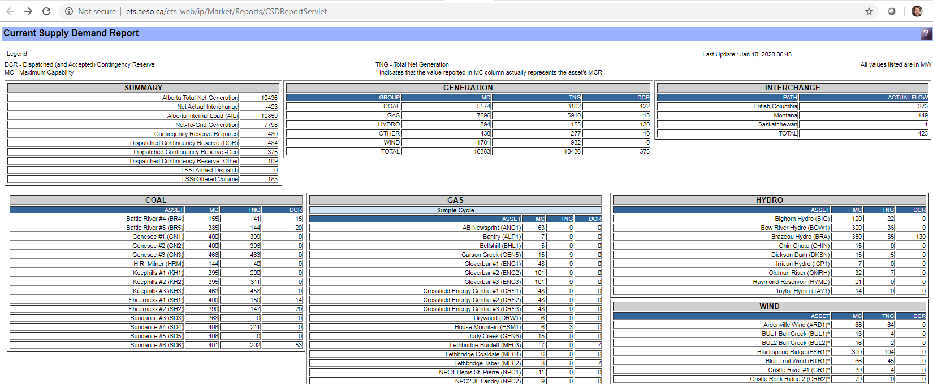
Basic Web Scraping
The page has many tables
Updated regularly
Has a “Last Update” field that we should probably retain.

Slide 16
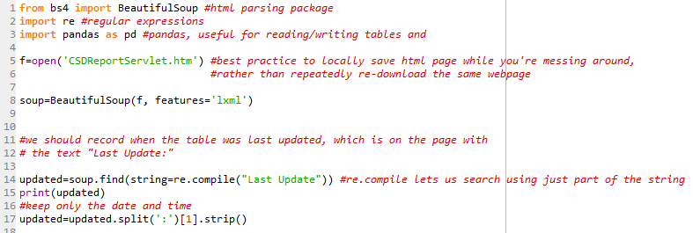
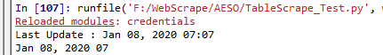
Basic Web Scraping
We’re using BeautifulSoup to parse the html
Most common functions are ‘find’ and ‘find_all’, which find the first example of something, or all examples of something
In this section we’re finding text, but it’s more common to search for html tags, or combinations of tags and text
Unintended consequence of my split – lost minutes after “07”!

Slide 17
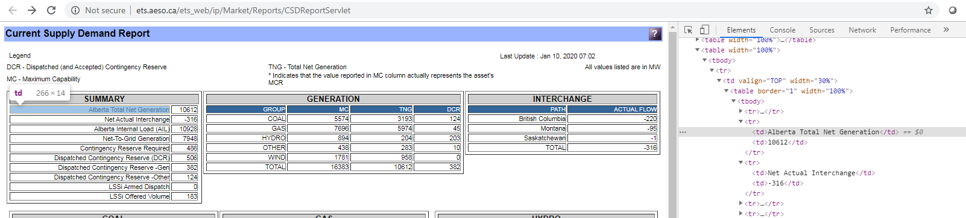
Basic Web Scraping
In Chrome, use ‘Inspect’ to see the html structure of part of a web page
We can see the table is in a tag “<tbody>”, with rows tagged “<tr>” and column elements tagged “<td>”

Slide 18
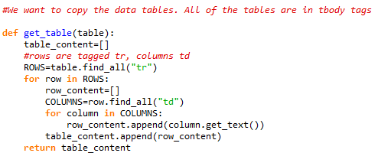
Basic Web Scraping
Once you’ve found a table, this function does the following:
Finds all rows (‘tr’ tags)
Finds all columns within that row (‘td’ tags)
Appends columns to a list, so that each row is represented as a list of elements
Appends row lists to a table list, so that a table is represented as a list of lists.
How do we find the table we want to apply the function to?
It turns out, nearly every element on the webpage is using the ‘tbody’ tag, not just the obvious tables.

Slide 19
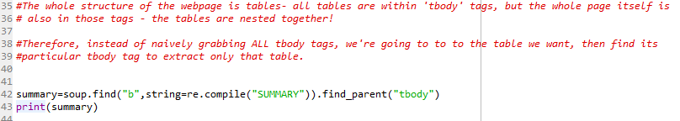
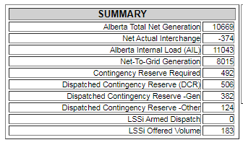
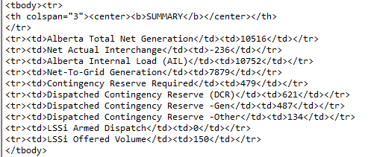
Basic Web Scraping
We have found the Summary Table’s tbody tag, now we can pass it through our function to clean it.

Slide 20
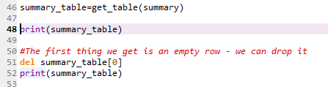
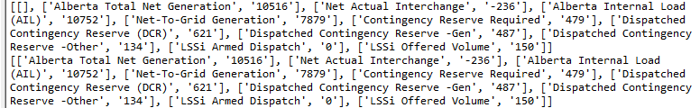
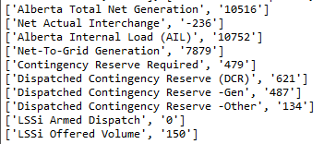
Basic Web Scraping

Slide 21
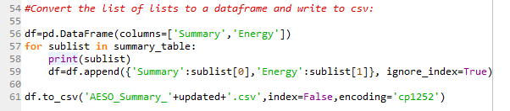
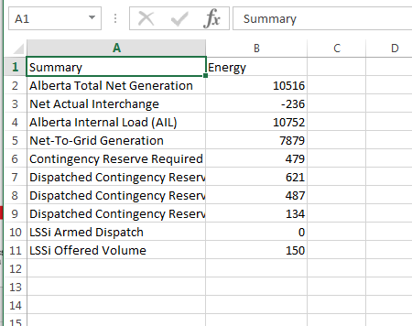
Basic Web Scraping
Finally, we append each row to a pandas DataFrame, and save as a CSV. We already recorded the time it was last updated, so we can include that in the file name when we save it.

Slide 22
THANK YOU AND GOOD LUCK!

